Slide 1
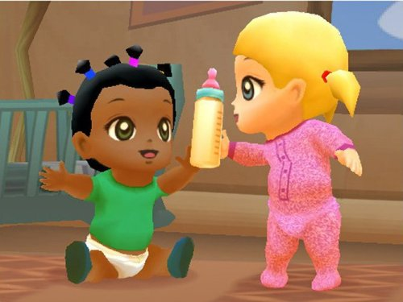
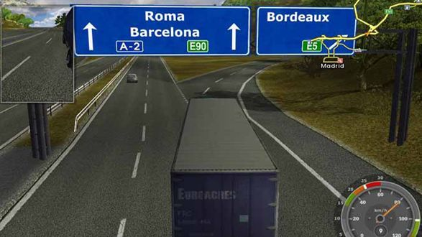

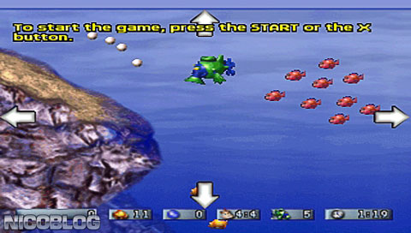
Most Boring Games!!!
Imagine: Babysitters,
Euro Truck Simulator
Let's Tap
Amazing virtual sea monkeys

Slide 2
Quick skill and interest level understanding Score yourself on a scale of 1-5 with 1 being the least.
Hardware
Software
UI
Logic/reasoning – math and incl AI
Narrative/story
Creative thinking – props, making avatars, objects
Behavioural analysis
marketing

Slide 3
Elements of a Game

Slide 4
Lets start with ‘Pong
https://www.youtube.com/watch?v=it0sf4CMDeM
“Avoid missing ball for high score.”
It is simple to play.
Every game is unique – endless possibilities
It is an elegant representation
It is social
It is fun
& finally it is cool

Slide 5
Now, lets understand GD from Schemas
RULES, PLAY, and CULTURE:
RULES contains formal game design schemas that focus on the essential logical and mathematical structures of a game.
PLAY contains experiential, social, and representational game design schemas that foreground the player's participation with the game and with other players.
CULTURE contains contextual game design schemas that investigate the larger cultural contexts within which games are designed and played.

Slide 6
Game mechanics – rules & procedures?
Game mechanics are the core of what a game truly is. They are the interactions and relationships that remain when all of the aesthetics, technology, and story are stripped away.
Mechanics of gameplay, even for simple games, tend to be quite complex, and very difficult to disentangle

Slide 7
Looks, feels, smells, tastes
Aesthetics
Rules & Procedures?
Or Methods to interact?
Mechanics
Story
Sequence of events set within a context?
Tech

Slide 8
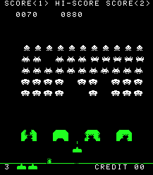
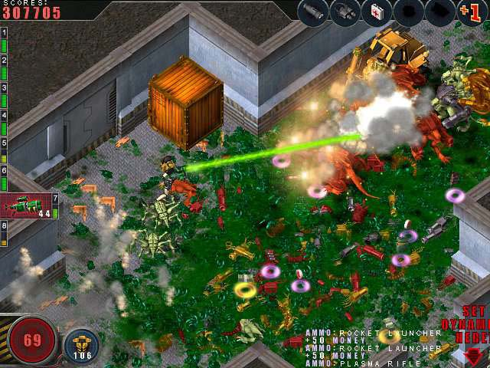
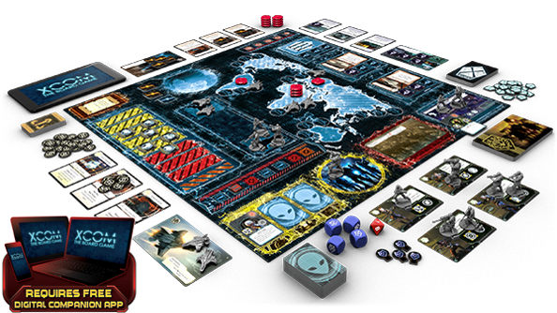
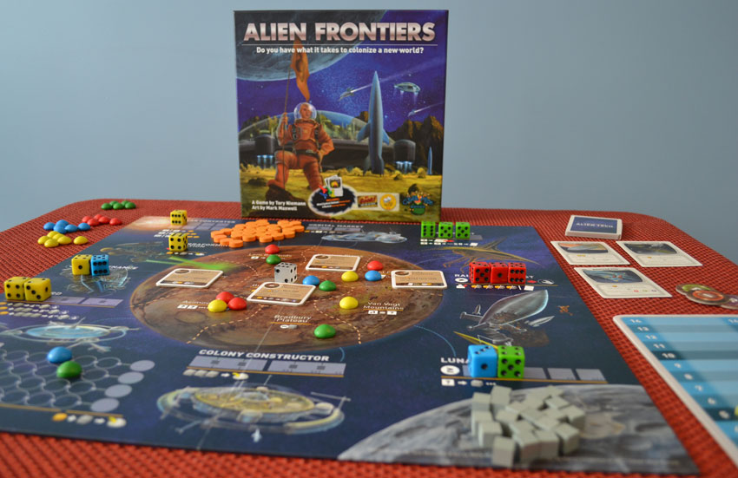
Case Study – Space Invaders/Aliens

Slide 9
Technology
Old➔ Custom motherboard (Intel 8080 CPU, raster graphics on a CRT monitor)
(https://www.youtube.com/watch?v=axlx3o0codc&index=1&list=PLEa2guN1k610Lm2aOQ7T8ObyQgXn-coLd)
New➔ Arcade : multiple CPUs, graphics and sound cards, tactile controls.
Console: difference in only the interface –usually keyboard.
Board➔ materials, props
Programming languages – C/C++; Java/Javascript; now we have game platforms – Unity or engines like Unreal or Cry.

Slide 10
Mechanics, Story, Aesthetics
Old/New➔ single player or multiplayer. Interaction by arrow or spacebar or specialized controls (arcade systems)
Board➔ multiplayer, turn based, chance and cooperative. Props & avatars.
Old/new/board➔ story is similar but rules are different.
Old/new/board➔ Aesthetics –very subjective??? (discuss)

Slide 11
Class Exercise (30 minutes)
Teams of 2-3
Select a 2D game
- For each, write the following:
What was the intended game experience
Objects /Roles
Describe behaviors of the objects (set of actions the objects perform in the game)
Relationships between objects & the game space.
Now, create an object/behavior that you think will make the game more interesting/intriguing/entertaining.

Slide 12
Reading & discussion assignment
http://gamestudies.org/0802/articles/sicart

Slide 13
Game Elements - Mechanics
M1 – SPACE
M2 – Objects, Attributes and States
M3 – Actions
M4 – Rules
M5 – Skill
M6 - Chance

Slide 14
Mechanic 1 - space
Every game takes place in some kind of space .
mathematical construct
game spaces:
1. are either discrete or continuous
2. have some number of dimensions
3. have bounded areas which may or may not be connected.
On a chess board, any point in space within a square is as good as any other point in space in the same square. In a football game, however, the game will probably use continuous space. Where a character is standing or running in a continuous space will have an effect on the shots the character fires at an opponent, whether moving or stationary.

Slide 15
The nuts & blots of Game space
Visual Space - What you see: walls, open sky, etc.
Physical barriers - Doors, gravity, environmental obstacles, weather
Soundtrack - Music, sound effects, etc.
Lighting - shadows, darkness, extreme brightness, etc.
Color - See the ways color choice effects mood

Slide 16
Space- example: tic-tac-toe
board that is discrete, and two-dimensional.
Only nine discrete places that have any actual meaning in the game.
What is discrete? – no movement between cells but adjacency in important.
X
=
=
X
X
X
=

Slide 17
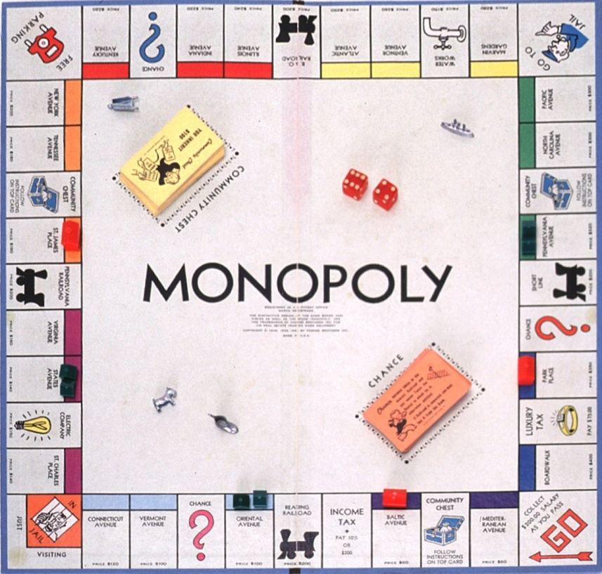
Discrete space

Slide 18
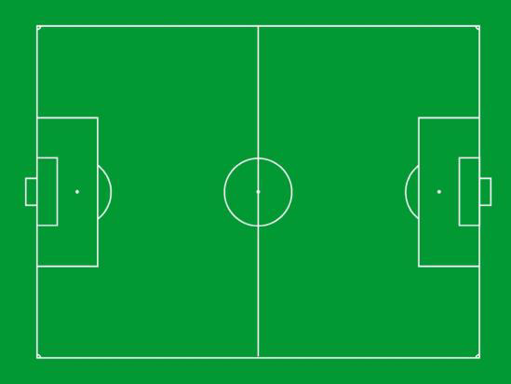
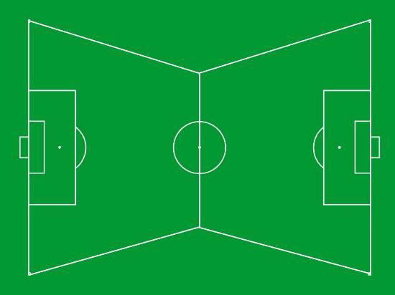
Discrete or continuous?

Slide 19
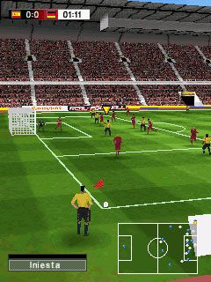
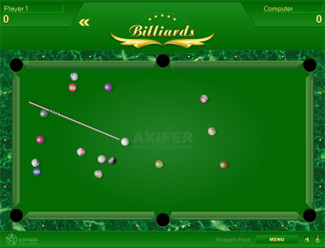
2-D or 3-D?

Slide 20
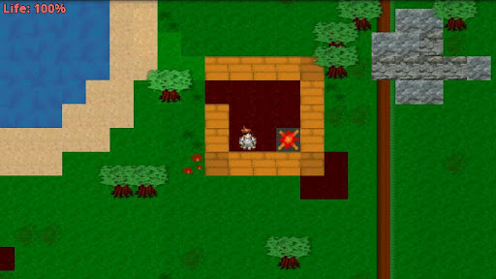
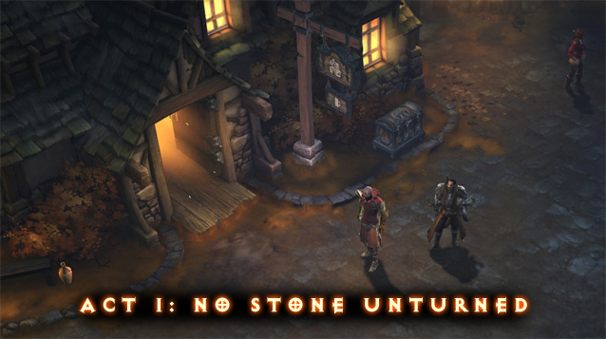
Nested Spaces
spaces within spaces

Slide 21
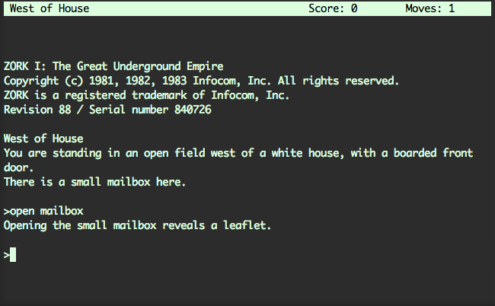
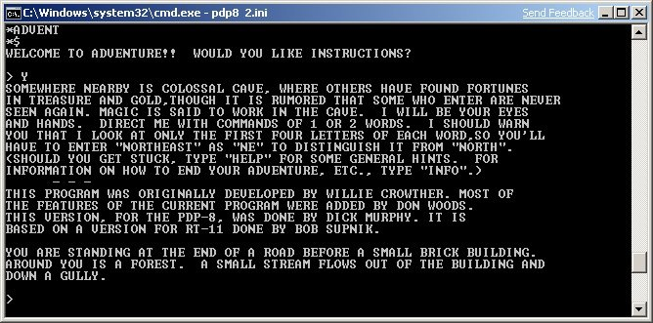
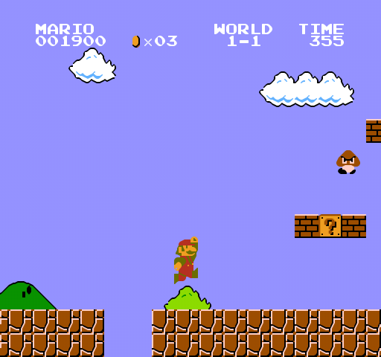
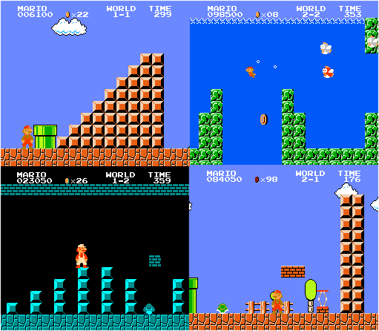
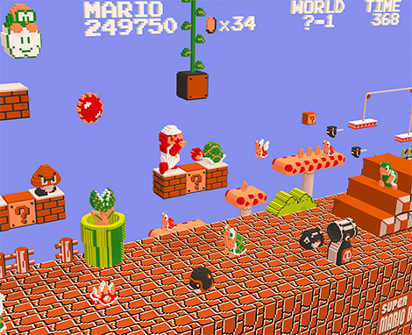
Dimensions
Zork?
Between 1977 and 1979 by MIT students Tim Anderson, Bruce Daniels, Dave Lebling, and Marc Blank
Colossal Cave
1976 by Will Crowther, a student
at Stanford
Space change by
clever use of background
Super Mario Brothers (2D Sliding)
Really 3D?
Or perceptive

Slide 22
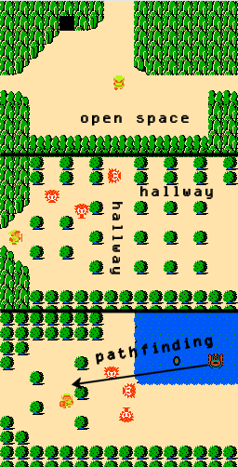
Space & dimensions
2D Top Down : Legend of Zelda.

Slide 23
Lens #21: The Lens of Functional Space
To use this lens, think about the space in which your game really takes place when all surface elements are stripped away.
Ask yourself these questions:
Is the space of this game discrete or continuous?
How many dimensions does it have?
What are the boundaries of the space?
Are there sub-spaces? How are they connected?
Is there more than one useful way to abstractly model the space of this game?
In the space I have defined, is the proposed game movement logical?

Slide 24

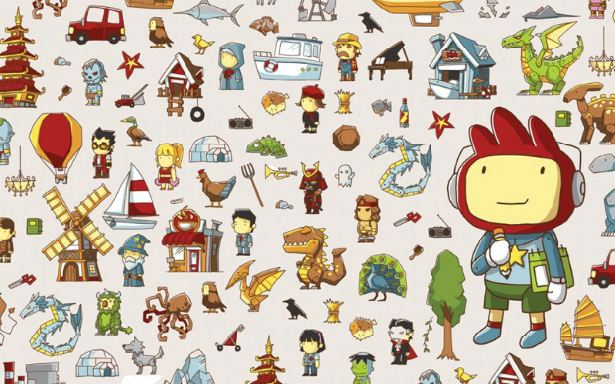
Mechanic 2: Objects, Attributes, and States
Characters, props, tokens, scoreboards, anything that can be seen or manipulated in your game falls into this category.

Slide 25
Objects & attributes & behaviors
Game relevant
Aesthetics
All objects have attributes which are categories of information about an object. They can be static or dynamic.
- example: speed of a rotor, height of a window/door, current & max speed for a car, role play, degrees of freedom, states …
What are the attributes of the object ‘king’ in chess game?
If objects are the nouns of game mechanics, attributes and their states are the adjectives.

Slide 26
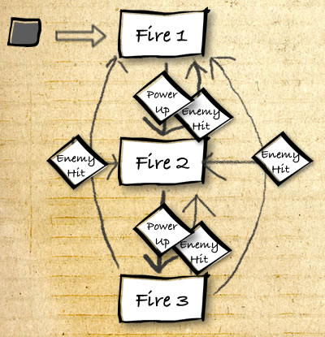
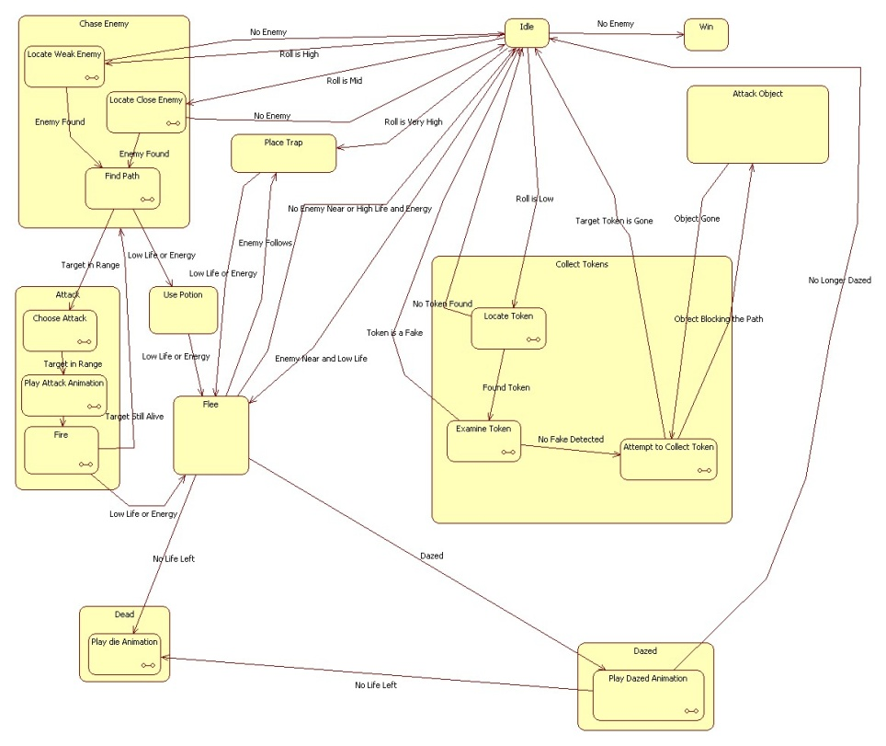
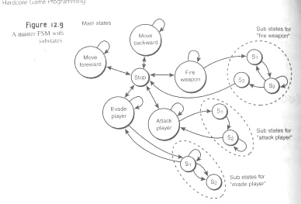
State diagram representation of objects & attributes

Slide 27
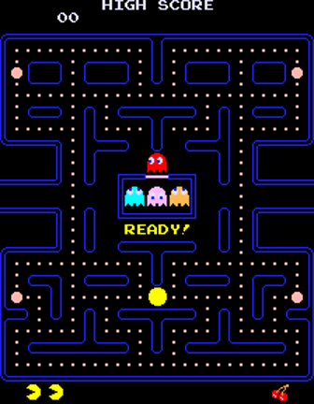
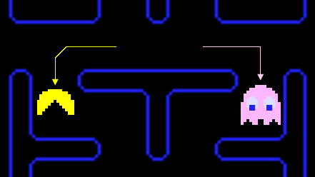
Case Study: Pac-Man
Space?
244 dots in the maze. 240 small of 10 points each
And larger dots (energy) with 50 points each.
Ghosts behavior modes:
Chase, Scatter, Frightened.
Math/AI of the Ghosts: How does the ghost find its
escape route when frightened?
Physics/math of pac-man: Why is the speed of pac-man
Regulated in the game? Advantage of cornering?
Created by Toru Iwatani, a self-taught coder/game developer

Slide 28
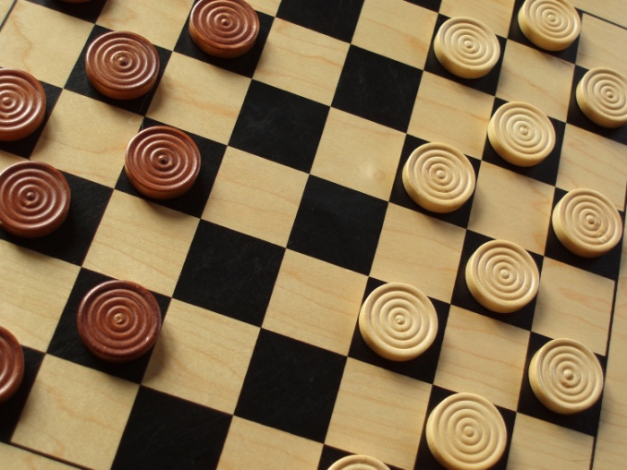
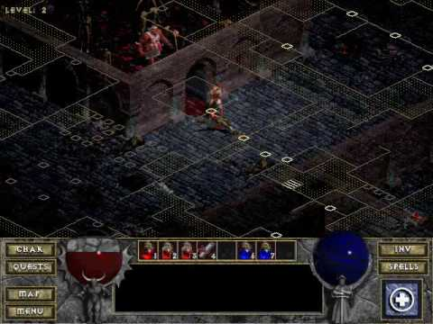
Properties/Behaviors
Checkers: Checkers have only three properties: color, location, and type. While the location of checkers changes, their color never does. A “normal” checker has two potential behaviors: It can move diagonally one space or jump diagonally to capture another piece.
Diablo: Extremely complex properties. Behaviors: It can move: running or walking. It can attack using weapons in its inventory or skills like magic spells. It can pick up objects, converse with other characters, learn new skills, buy or trade objects, open doors or boxes,

Slide 29
Relationships
If there are no relationships between the objects in question, then you have a collection, not a system.
A game played on a board might express relationships between objects based on location. Alternately, relationships between objects might be defined hierarchically.
For example of a fixed relationship: The hierarchy of cards: The numerical values fix a logical relationship between each of the cards in the set.
Example of changing relationship: In Checkers, as the pieces/objects move, jump and capture the relationship with the board and other objects changes.
In The Sims: the relationships of the characters to other objects are based on their current needs. For example, the refrigerator is more interesting to a character that is hungry than a character who has just eaten a huge meal.

Slide 30
Tic_Tac-Toe
Objects: spaces on the board (9)
Properties: “null”, “x”, or “o”.
Relationships: defined by location. There is one center space, four corners, and four sides. When the game begins, the relationship between the spaces is such that there are only three meaningful choices for the first player: center, corner, or side. The second player has between two and five meaningful choices, depending on where the first player put an “x”…and so on.

Slide 31
States
Private (not known to the other player)
Public( all information is open)
God,Game,Players

Slide 32
Secrets – game attributes & objects
Chess/monopoly – all information is open to all players.
Poker - hidden or private state is a big part of the game. Games become dramatically different when you change what information is public or private.
(in online poker: player, virtual opponent algo, main game algo – question: can the computer cheat?)
Board games such as Battleship and Stratego are all about guessing the states of your opponent’s private attributes.
In videogames, we face something new: state that only the game itself knows about.
The secret keepers: the player, the virtual opponent algorithm and the main game algorithm.

Slide 33
Lens #22: The Lens of Dynamic State
To use this lens, think about what information changes during your game, and who is aware of it. Ask yourself these questions:
What are the objects in my game?
What are the attributes of the objects?
What are the possible states for each attribute? What triggers the state changes for each attribute?
What state is known by the game only?
What state is known by all players?
What state is known by some, or only one player?
Would changing who knows what state improve my game in some way?

Slide 34
Case Study – Tension and release effect through mechanics.
Every Extend Extra - Saturday Night Drive (Q Entertainment 2006) (http://www.youtube.com/watch?v=I250DxvuXUM)
Tension is built while avoiding enemies without providing any input, and release comes when the player finds the right timing and place to trigger the explosion.

Slide 35
Objects, attributes & states – the Human Intelligence or Artificial Intelligence part and the classes of games aspects.

Slide 36
Classes of Games
Deterministic v. Non-deterministic
Chess v. backgammon
Perfect Information v. Imperfect information
Checkers v. Bridge
Zero-sum (strictly competitive)
Prisoners dilemna

Slide 37
classification of games according to:
Number of players
most of the board games have two players.
Goal
zero-sum game: your win is the opponent’s loss (1, -1)
non-zero-sum game: you could all win or all lose (focus on your own winning, rather than your opponent losing)
With more than two players and zero-sum games, best strategy may not be making every opponent loose.
Information
perfect information fully observable environment - complete knowledge of every move your opponent could possibly make.
imperfect information partially observable environment -eg, random element that makes unforeseeable which move you and the opponent will take.

Slide 38
Classes of Games - examples
 | Deterministic | Chance
Perfect information | Chess, checkers, go, othello, chinese checkers | Backgammon, monopoly, risk
Imperfect information | Stratego | Bridge, poker, scrabble, (real life)

Slide 39
Reference text: Programming Game AI by example
Objects, Attributes & States – the GAME AI
What is artificial intelligence (AI) ?
subfield of computer science ?
subfield of cognitive science ?
What is “AI for Games” ?
versus “academic AI” ?
Notes:
“science of AI studies intelligent behaviour,
not who or what is producing the behaviour. It studies natural
language understanding, for instance, not natural language
understanders. This is what makes AI quite dierent from the
study of people (in neuroscience, psychology, cognitive science,
evolutionary biology, and so on).” – by Levesque, IJCAI 2013 paper

Slide 40
Class exercise – Pac Man state states
Make a state diagram representation for the pac man game.
- can do for the ghosts or pac man
Objects , attributes and states.

Slide 41
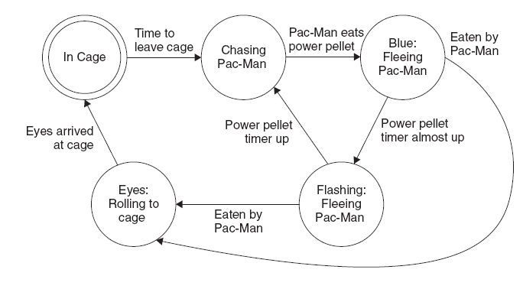
Attribute
Of the Ghosts!

